Slide 1
Introduction to Computer Simulation of Physical Systems (Lecture 1)
PHYS 3061

Slide 2
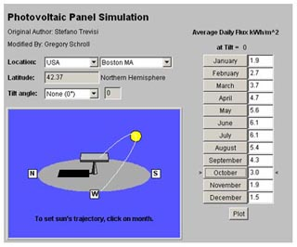

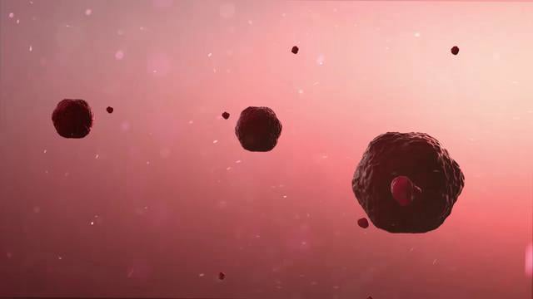
Importance of computers in physics
How can I formulate a physical problem on a computer?
New ways of thinking about physics
numerical analysis, symbolic manipulation, visualization, simulation, and the collection and analysis of data

Slide 3
Numerical analysis:
the solution of well-defined mathematical problems to produce numerical solutions
to compute multidimensional integrals, manipulate large matrices, or solve nonlinear differential equations…
Why Nonlinear is so important?
Matrix operation will be covered in 4061.

Slide 4
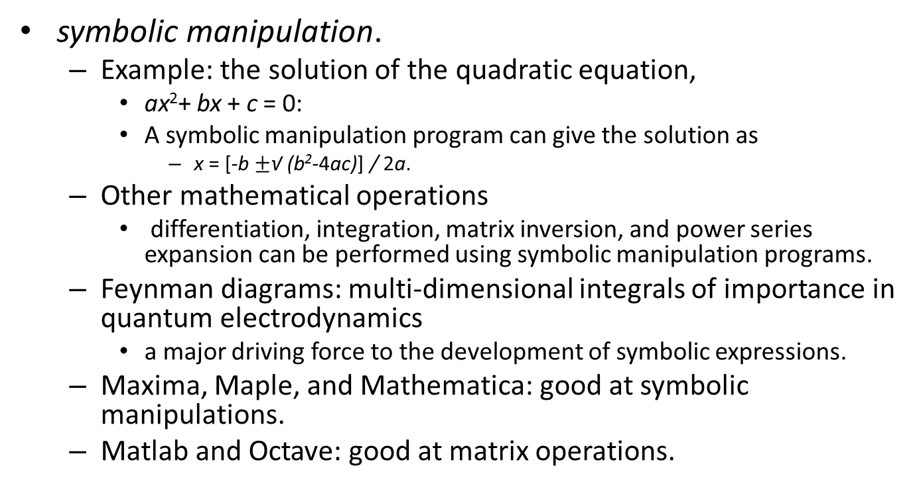
symbolic manipulation.
Example: the solution of the quadratic equation,
ax²+ bx + c = 0:
A symbolic manipulation program can give the solution as
x = [-b $±$√ (b²-4ac)] / 2a.
Other mathematical operations
differentiation, integration, matrix inversion, and power series expansion can be performed using symbolic manipulation programs.
Feynman diagrams: multi-dimensional integrals of importance in quantum electrodynamics
a major driving force to the development of symbolic expressions.
Maxima, Maple, and Mathematica: good at symbolic manipulations.
Matlab and Octave: good at matrix operations.

Slide 5
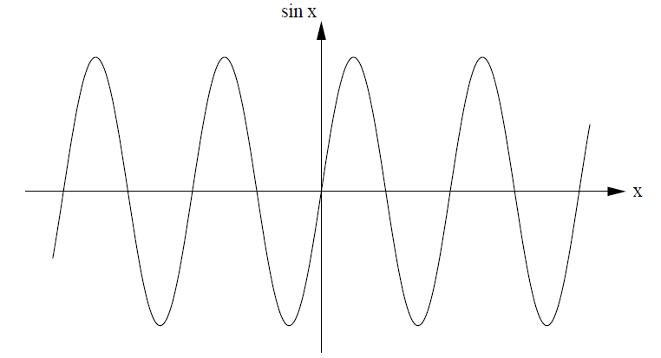
visual representation
Our eyes can determine patterns and trends easily to further understand the physical mechanisms.
The use of graphics also can increase our understanding of the nature of analytical solutions.
sin x = x-x³/3!+x⁵/5! +. . ., vs.
Traditional modes of presenting data:two- and three-dimensional plots.
Question: more than three variables ? Why humanbeings are good at recognize patterns?

Slide 6
computer simulation
implement the model on a computer:
to understand the behavior of the model and its predictions.
Example:
teacher and each student in a class of 100 has $10.
The teacher randomly chooses a student and flips a coin.
If the coin is heads, the teacher gives $1 to the student;
otherwise, the student gives $1 to the teacher.
If either the teacher or the student would go into debt by this transaction, the transaction is not allowed.
After many exchanges, what is the probability that a student has s dollars? What is the probability that the teacher has t dollars? Are these two probabilities the same?
Although these particular questions can be answered by analytical methods, many problems of this nature cannot be solved in this way!

Slide 7
One way: do a classroom experiment.
difficult to arrange
tedious to do a sufficient number of transactions.
A more practical way:
model into a computer program, simulate many exchanges, and estimate the quantities of interest.
We can even modify a lot of conditions in the simulation to gain more insights.
For example, will the results change if we allow loans between students? What will happen if the teacher is allowed to be in debt?
Simulations often use computation tools of numerical analysis and visualizations.
Often a good research work is a combination of simulations, analysis and experimental work….
Why do we still want to perform some analysis even after we obtain the simulation results? What is the relationship between simulation and experiment?

Slide 8
collection and analysis of data
Some of the roles of the computer in laboratory experiments
the varying of parameters and the analysis of data, are similar to those encountered in simulations.
The successful launch of long march 5 rocket
A large scale simulation was involved
To seek for the cause of failure in the previous launch with limited input of observation data collected before the failure.

Slide 9

Why is Computer simulation important?
most of our analytical tools such as differential calculus are best suited to the analysis of linear problems.
many natural phenomena are nonlinear, and a small change in a variable might produce a large change in another!
Three body problems are not analytically solvable!
few nonlinear problems can be solved by analytical methods
the computer gives us a new tool to explore nonlinear phenomena.

Slide 10
the growing interest in systems with many variables or with many degrees of freedom.
The money exchange model.
computer experiments
First step: development of an idealized model.
Second step: specify a procedure or algorithm and decide what quantities to measure.
a bridge between laboratory experiments and theoretical calculations.
a third way of doing physics and complements both theory and experiment.
The goal:
to seek explanations of natural phenomena that can be stated concisely.

Slide 11
Why is computer simulation important?
Simulations are faster, cheaper or often the only possible way to do the research.
Systems at extreme conditions (High pressure, low temperature, etc...）
Not politically allowed, nuclear weapon simulations…
When you obtain the experiment results, it’s often too late… (Material failure problems, Civil engineering problems, stock market predictions…)
Are there counter examples, for example, simulation is slower or more expensive?

Slide 12
Why is computer simulation important?
easy to do, even for very complexed systems;
their complexity is no worse than the complexity of the physical description.
purely theoretical approaches typically are applicable only to very simplified models.
Simulations are good for learning about a system and to get a good idea of what is going on.
Also they are a good black box for non-experts since one does not have to master a particular theory to understand the input and output of a simulation.

Slide 13
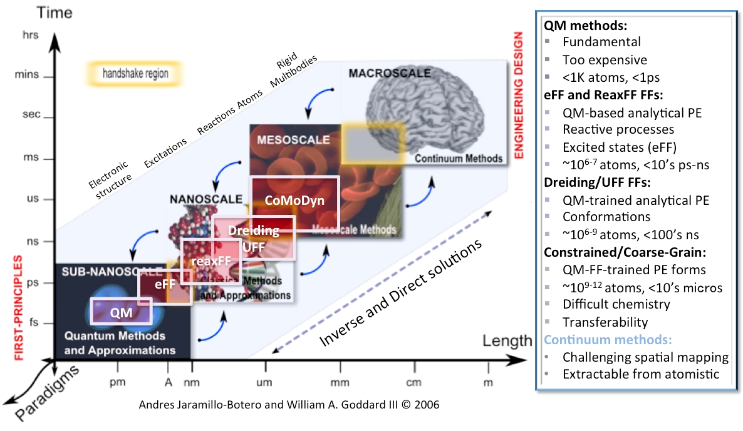
Why is computer simulation important?
Scale up very fast. From a few atoms to millions of them!

Slide 14

Is the whole universe a quantum simulation?
We don’t know.
Interaction vs. object.
Why Quantum states are often discretized?
Coupling of quantum states or qubits can give us a sense of 3d space.
Suppose you live in such a matrix, is it possible to figure out you live in such a matrix?

Slide 15
Programming languages
Strongly encouraged to use C/C++ or JAVA in the lab. Class lectures will use JAVA code as illustrations.
C:
developed by Dennis Ritchie
at Bell Laboratories around 1972 in parallel with the Unix operating system.
C++:
an extension of C designed by Bjarne Stroustrup
at Bell laboratories in the mid-eighties.

Slide 16
C++
more complex than C,
object oriented features, and other extensions.
C/C++ have high performance, difficult to debug.
popular choices for developing operating systems and software applications
provide direct access to memory and other system resources.

Slide 17
Java:
object-oriented language
created by James Gosling and others at Sun Microsystems.
introduced in late 1995,
rapidly evolved, very popular and is the language of choice in most introductory computer science courses.
Java borrows much of its syntax from C++, but has a simpler structure.
contains only fifty keywords
the Java platform adds a rich library
enables a Java program to connect to the internet,
render images,
perform other high-level tasks.

Slide 18
The idea of object-oriented programming
functions and data are grouped together in an object, rather than treated separately.
A program is a structured collection of objects that communicate with each other causing the internal state within a given object to change.
A fundamental goal of object-oriented design
to increase the understandability and reusability of program code by focusing on what an object does and how it is used, rather than how an object is implemented.

Slide 19
Java: a platform in itself
similar to the Macintosh and Windows
it has an application programming interface (API) that enables cross-platform graphics and user interfaces.
Java programs are compiled to a platform neutral byte code so that they can run on any computer that has a Java Virtual Machine.
Despite the high level of abstraction and platform independence, the performance of Java is becoming comparable with native languages.
If a project requires more speed, the computationally demanding parts of the program can be converted to C/C++ or Fortran.

Slide 20
Very Brief introduction on OOP
Encapsulation : the way that an object’s essential information is exposed through a well-documented interface, but unnecessary details of the code are hidden.
For example, we can model a particle as an object.
Whenever a particle moves, it calculates its acceleration from the total force on it.
to use the trajectory of the particle,
for example to animate the particle’s trajectory,
refer only to the interface
no need to know how the trajectory is calculated.

Slide 21
Inheritance
allows a programmer to add capabilities to existing code without having to rewrite it or even know the details of how the code works.
For example, programs show the evolution of planetary systems, quantum mechanical wave functions, and molecular models..

Slide 22
They can share a library code called timer
periodically executes code in your program and then refreshes the on-screen animation.
Later, on programming the physics, because it is not necessary to write the code to produce the timer or to refresh the screen.
Similarly, we can design a general purpose graphical user interface (GUI) by extending code written by Sun Microsystems known as a JFrame.
Our GUI has the features of a standard user interface such as a menu bar, minimize button, and title, even though we did not write the code to implement these features.

Slide 23
Polymorphism: helps us to write reusable code.
For example, it is easy to imagine many types of objects that are able to evolve over time.
We can simulate a system of particles using random numbers rather than forces to move the particles.
Any examples?
By using polymorphism, we can write general purpose code to do animations with both types of systems.

Slide 24
A few important things you should keep in mind in this course
Analysis of results.
What physical insights can you gain from your simulations?
How do we go from numbers to "understandings" ?

Slide 25
Programming and debugging techniques. How do we gain confidence that the computer code is correct: it is doing what we think it should be doing?
Details on debugging techniques will be covered in lab sessions.

Slide 26
Learn to explain the logic behind why simulations are done in a particular way.
In the whole semester, you will be required to finish one large class project on molecular dynamics
Why MD?
It will be separated into small pieces
You will understand all the details in the simulation!

Slide 27
Course contents
Random Process: Particle in a box, random number generator, very brief introduction of random walk.
Cooling problem: Euler algorithm for solving first-order differential equations. Brief introduction to high order algorithm.

Slide 28
Course contents
Single particle motion : Newton’s equation of motion.
Molecular dynamics: Verlet algorithm, hard ball potential, LJ potential, RDF, how to calculate thermal properties.
chaotic dynamics: Briefly discuss simple deterministic nonlinear models which exhibit complex patterns of behaviour.
How to solve PDE.
Electrostatic problems: Brief introduction of relaxation method, finite difference method.
Monte Carlo simulation
If we still have time, we may try some advanced topics in simulations.

Slide 29
Course Contents
4 computational laboratories (3 hours each) for one large molecular dynamic simulation project, one lab in chaotic motion and one lab in PDE.
Presentation of your simulation project results (5 min) + one freely selected presentation on literature reviews of simulations (5 min). Topics need to be preapproved by me.

Slide 30
Lab 0: Write a few small functions on dot product and cross product and getting familiar with the software and systems.

Slide 31
Lab 1 • Random walk, 3d, symmetric probability , random initialization (Maxwell Boltzmann distribution)
monitoring position, energy, momentum, angular momentum
Lab 2
• Ideal gas particle, particle in a box, • Euler method for integration Lab 3 • Verlet algorithm • L J potential Lab 4 • Radial distribution function • Heat bath, thermal properties.

Slide 32
Lab 5, Chaotic motion
Lab 6, solving PDE.

Slide 33
Assessment Scheme
Project: 55%
The deadlines of code, simulation results or lab report are in two weeks from the lab date.
Final Project on MD or MC: 25%
Presentation of literature review: 5 %
Homework: 10%
Class activity: 5%
Answer important questions, point out important errors in lecture notes, frequent communications in the classroom. Class attendance will be taken randomly.

Slide 34
Reference books
Textbook, Harvey Gould, Jan Tobochnik and Wolfgang Christian : An Introduction to Computer Simulation Methods: Applications to Physical Systems, third edition 2007 Pearson/Addison-Wesley
Harvey Gould and Jan Tobochnik : An Introduction to Computer Simulation Methods, second edition 1996 Addison-Wesley
(W) Samuel S M Wong : Computational Methods in Physics and Engineering, 1997 World-Scientific
William H Press et al : Numerical Recipes in FORTRAN : the Art of Scientific Computing, 1992 Cambridge University Press
William H Press et al : Numerical Recipes in C : the Art of Scientific Computing, 1988 Cambridge University Press
Tao Pang : An Introduction to Computational Physics, 1997 Cambridge University Press for program listings in Fortran 90 and Mathematica
Alejandro L Garcia : Numerical Methods for Physics, second edition 2000 Prentice Hall for program listings in MatLab and C++
Nicholas J Giordano : Computational Physics, 1997 Prentice Hall for program listings in True Basic

Slide 35
Tools for doing simulations
Present some essential syntax of Java for you to understand.
We’ll use VMD to plot your simulation results. The details of VMD will be covered in the lab sessions.

Slide 36
Making models:
If the model is sufficiently detailed, we can determine its behavior, and then compare the behavior with experiment.
verification of the model, changes in the model, and further simulations and experiments.
begin with a set of initial conditions.
determine the dynamical behavior of the model numerically
generate data in the form of tables of numbers, plots, and animations.
We begin with a simple example to see how this process works.

Slide 37
Suppose a particle near the surface of the Earth subject to the force of gravity.
We assume that air friction is negligible and the gravitational force is given by
F_{g} = -mg,
where m is the mass of the ball and g = 9.8 N/kg is the gravitational field (force per unit mass) near the Earth’s surface.

Slide 38
Suppose the problem with only y direction, we use Newton’s second law to find the motion of the ball,
m d²y/dt² = F,
Or d²y/dt² = g.
You know the solution, right?
y(t) = y(0) + v(0)t – ½ gt²
v(t) = v(0) - gt.

Slide 39
Suppose we don’t know the solution and are trying to solve the ODE.
dy/dt= v
dv/dt= -g,
Approximation comes:
(y(t + Δt)- y(t))/Δt= v(t)
(v(t + Δt) - v(t))/Δt= -g.

Slide 40
y(t + Δt) = y(t) + v(t)Δt
v(t + Δt) = v(t) - gΔt,
The above finite difference method is called Euler algorithm.
We can initialize y0 and v0 and iterate!
If Δt is small enough, we can achieve very accurate results!

Slide 41
One example:
First order differential equation:
dy/dx = f(x),
y_{n+1} = y_{n} + f(x_{n})Δx.

Slide 42
Suppose that f(x) = 2x and y(x = 0) = 0.
The analytical solution is y(x) = x².
Find the finite difference equation using the Euler algorithm.
For simplicity, choose Δx = 0.1. It would be a good idea to first use a calculator or pencil and paper to determine y_{n} for the first several time steps.

Slide 43
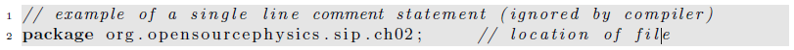
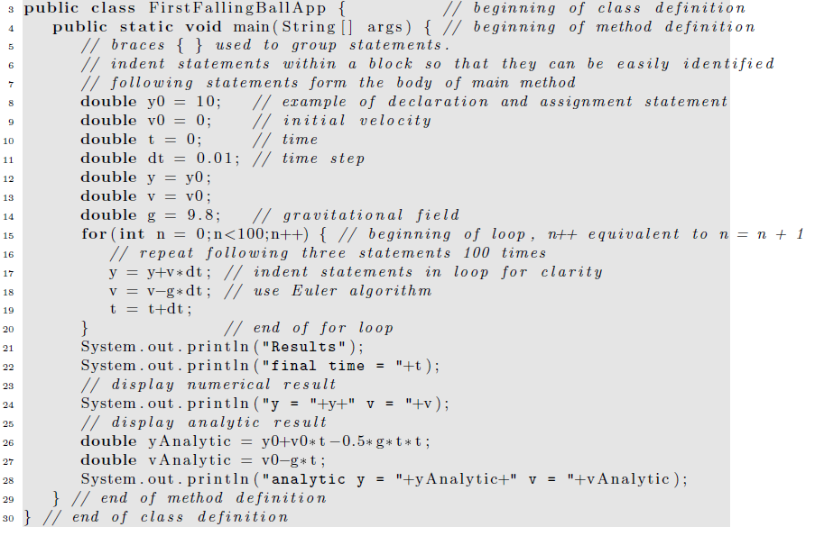

Slide 44
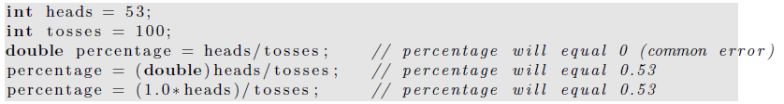
One common error:
For loop, while loop, do while loop.

Slide 45
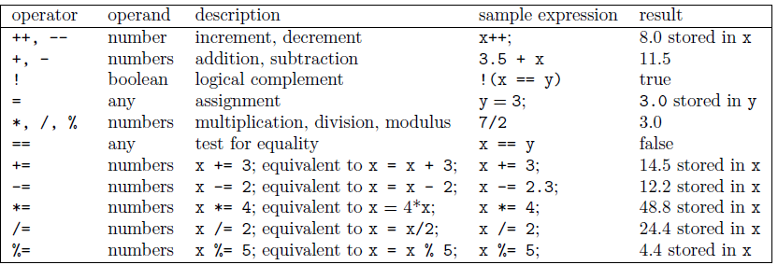
Common opperators:

Slide 46
How to write bug free code?
Suppose you’ll be writing a large simulation program consisting thousands of lines or more, any principles you can apply to write bug free code?
Any suggestions?

Slide 47
Very brief introduction of classes and objects
separate the implementation of the model from the implementation of other programming tasks such as producing output.
One example in the next page only handles the model part

Slide 48
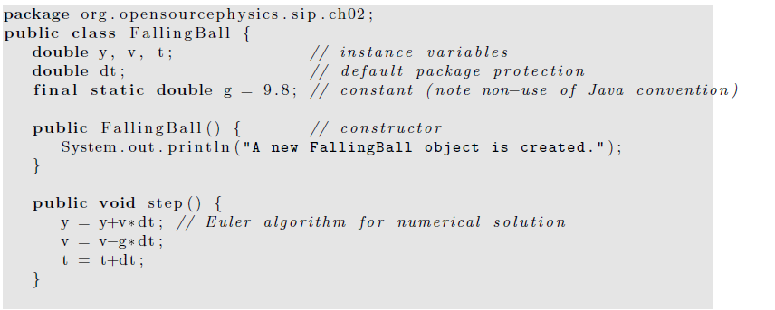
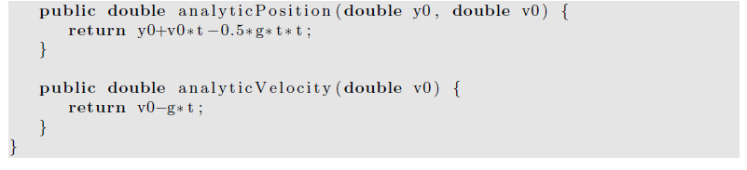

Slide 49
a class is a blueprint for creating objects, not an object itself.
The above class can’t be used in isolation because it’s not instantiated (object is created) yet!
We can write another class with a main method to instantiate it.

Slide 50
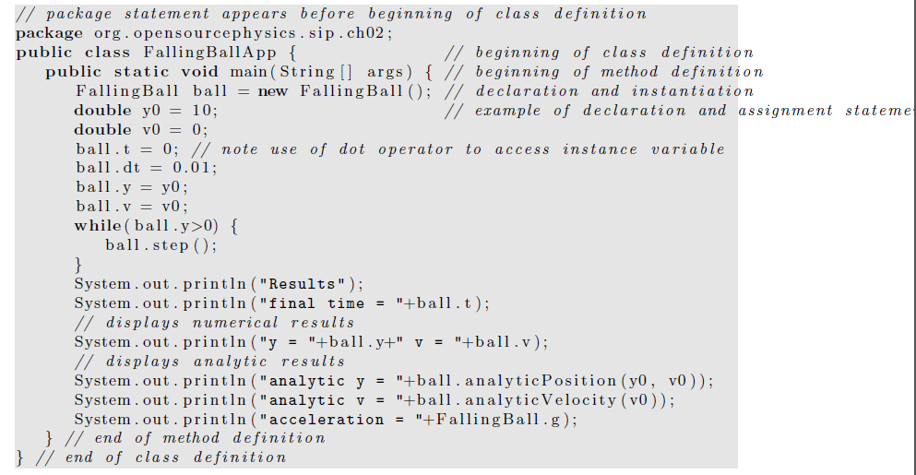

Slide 51
FallingBall ball = new FallingBall ();
The declaration statement tells the compiler that the variable ball is of type FallingBall.
It is analogous to the statement int x for an integer variable.
The new operator allocates memory for this object, initializes all the instance variables, and invokes the constructor.

Slide 52
Another example of a single Harmonic oscillator will be shown in the next page.
This example solves a very simple harmonic oscillator problem:
dx/dt =v,
dv/dt = -kx /m

Slide 53
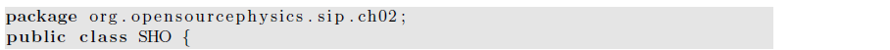
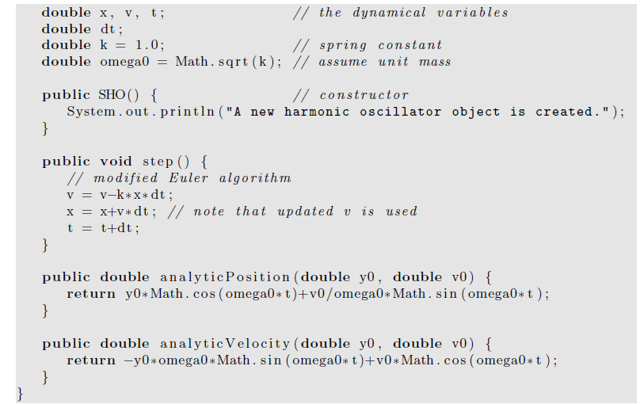
Explain how the implementation of the Euler algorithm in the step method of class SHO differs from what we did previously.

Slide 54
static methods can be used directly without first creating an object.
A class that is included in the core Java distribution and that we will use often is the Math class
which provides many common mathematical methods, including trigonometric, logarithmic, exponential, and rounding operations, and predefined constants.
Some examples of the use of the Math class include:

Slide 55
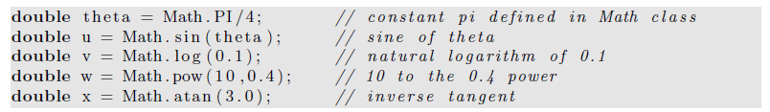

Slide 56
Inheritance
The falling ball and the simple harmonic oscillator have important features in common.
Both are models of physical systems
all its mass were concentrated at a single point.
Writing two separate classes by cutting and pasting is straightforward and reasonable because the programs are small and easy to understand.
But this approach fails when the code becomes more complex.

Slide 57
For example, suppose that you wish to simulate a model of a liquid consisting of particles that interact with one another according to some specified force law.
Because such simulations are now standard, efficient code for such simulations is available.
In principle, it would be desirable to use an already written program, assuming that you understood the nature of such simulations.

Slide 58
However, in practice, using someone else’s program can require much effort if the code is not organized properly.
Fortunately, this situation is changing as more programmers learn object oriented techniques, and write their programs so that they can be used by others without needing to know the details of the implementation.

Slide 59
For example, suppose that you decided to modify an already existing program by changing to a different force law.
You change the code and save it under a new name.
Later you discover that you need a different numerical algorithm to advance the particles’ positions and velocities.
You again change the code and save the file under yet another name.

Slide 60
At the same time the original author discovers a bug in the initialization method and changes her code.
Your code is now out of date because it does not contain the bug fix.
Although strict documentation and programming standards can minimize these types of difficulties, a better approach is to use object oriented features such as inheritance.
Inheritance avoids duplication of code and makes it easier to debug a number of classes without needing to change each class separately.

Slide 61
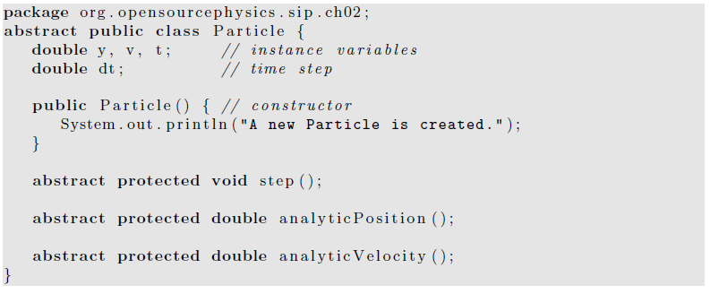
The abstract keyword : define the Particle class without knowing how the step, analyticPosition, and analyticVelocity methods will be implemented.
Abstract classes are useful in part because they serve as templates for other classes.
The abstract class contains some but not all of what a user will need.
By making the class abstract, we must express the abstract idea of “particle” explicitly and customize the abstract class to our needs.

Slide 62
By using inheritance we now extend the Particle class (the superclass) to another class (the subclass).
The FallingParticle class implements the three abstract methods.
Note the use of the keyword extends.
We also have used a constructor with the initial position and velocity as arguments.

Slide 63
